Slide 1

Operating systems
Lecture # 26 - 29

Slide 2
Lecture Overview
Non - Contiguous Memory Allocation
Paging
2 Level Paging
Segmentation
Segmented Paging

Slide 3
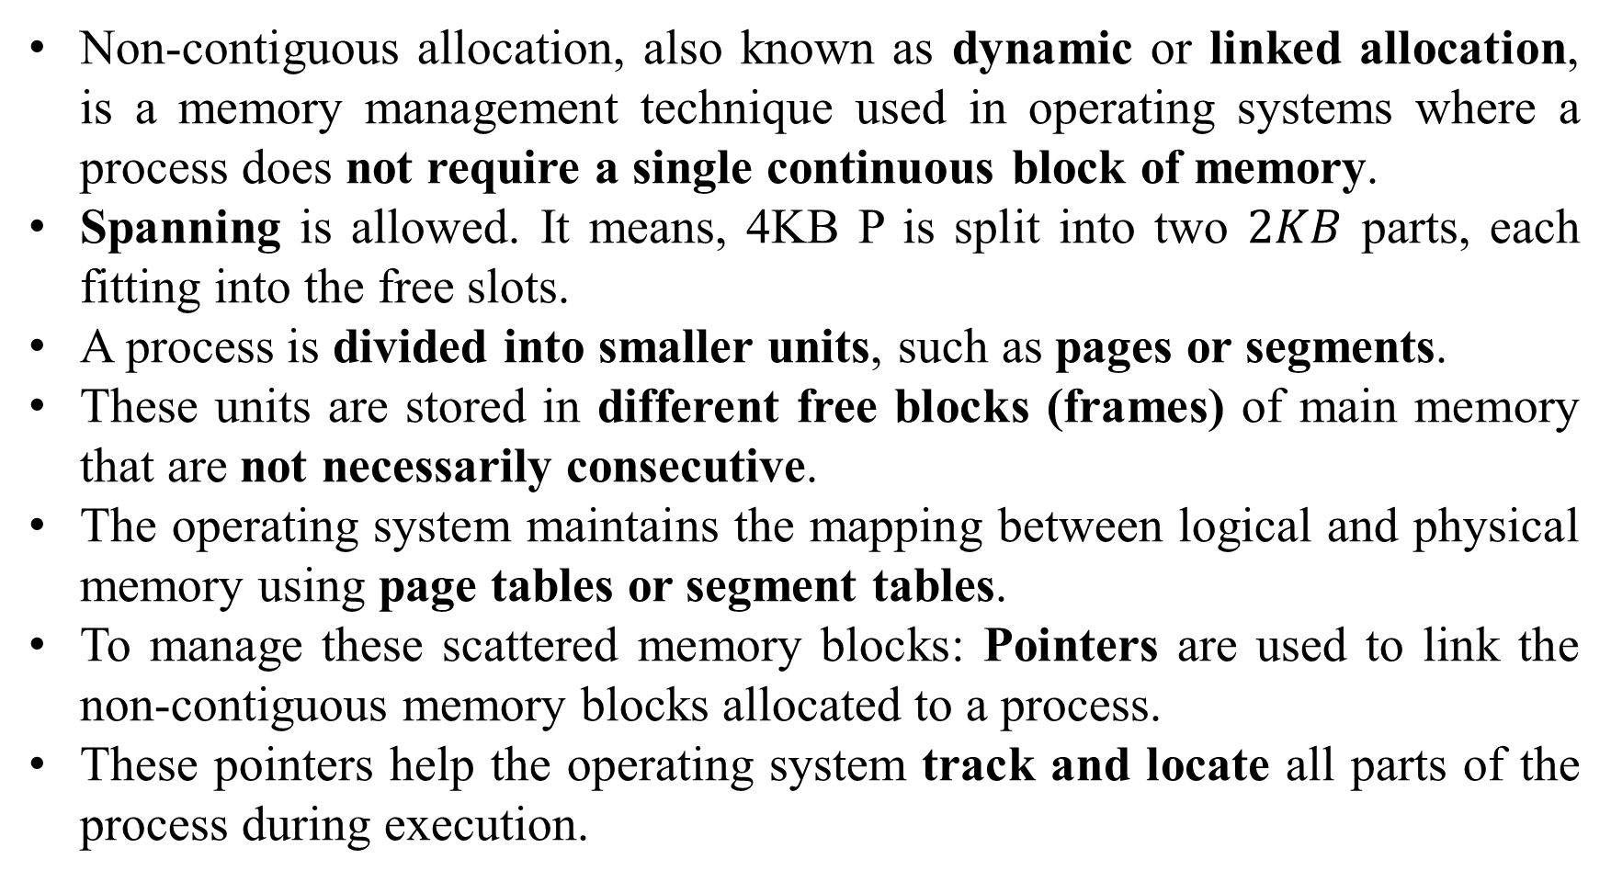
Non - Contiguous Memory Allocation
Non-contiguous allocation, also known as dynamic or linked allocation, is a memory management technique used in operating systems where a process does not require a single continuous block of memory.
Spanning is allowed. It means, 4KB P is split into two $2KB$ parts, each fitting into the free slots.
A process is divided into smaller units, such as pages or segments.
These units are stored in different free blocks (frames) of main memory that are not necessarily consecutive.
The operating system maintains the mapping between logical and physical memory using page tables or segment tables.
To manage these scattered memory blocks: Pointers are used to link the non-contiguous memory blocks allocated to a process.
These pointers help the operating system track and locate all parts of the process during execution.

Slide 4
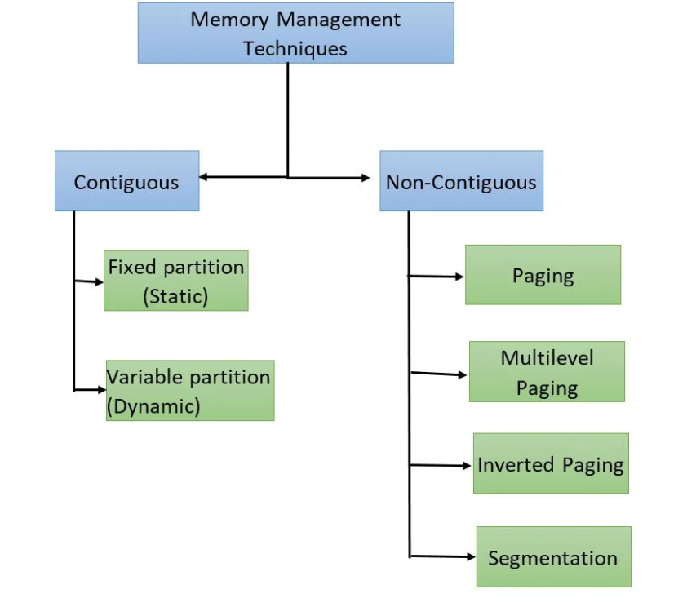


Slide 5
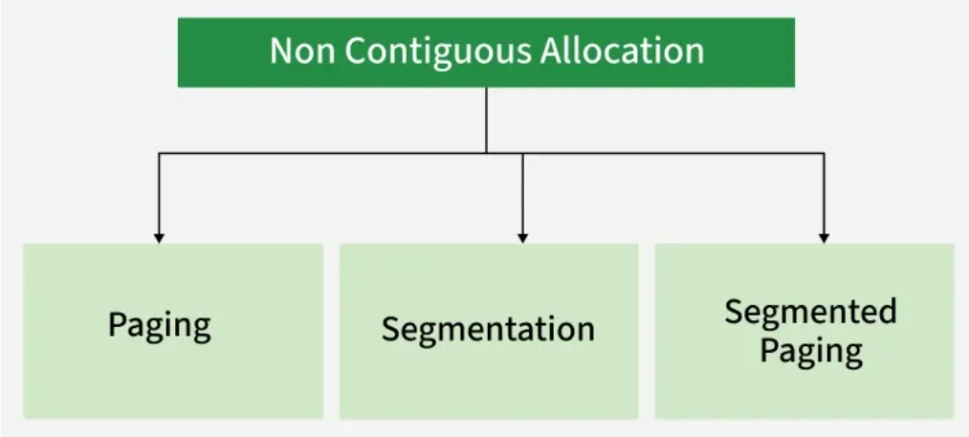
1. Paging
Paging divides a process into fixed-size pages and maps them to fixed-size memory frames. Its primary objective is to eliminate external fragmentation by allowing non-contiguous allocation of pages in physical memory.
However, paging may suffer from internal fragmentation if the last page is not completely filled.
2. Segmentation
It divides a process into variable-sized logical segments, such as code, data, and stack. It supports logical organization, memory protection, and sharing, as each segment represents a meaningful program unit.
Segmentation may suffer from external fragmentation due to variable-sized segment allocation.
3. Segmented Paging
Segmented paging is a hybrid memory management technique that:
Divides a process into logical segments, and
Further divides each segment into fixed-size pages.

Slide 6
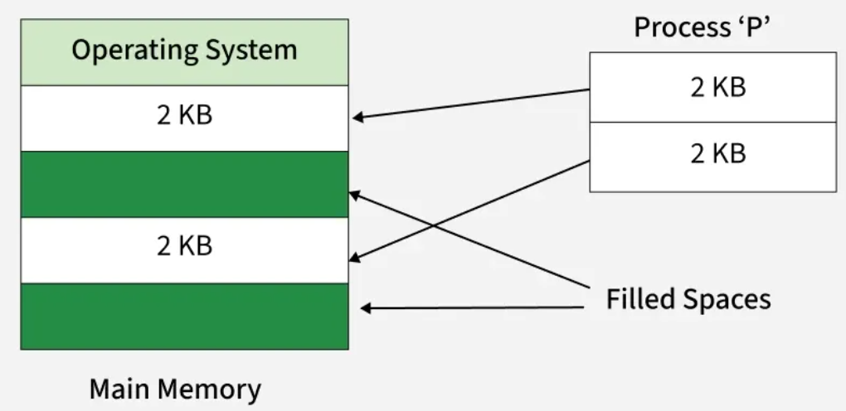
Non - Contiguous Memory Allocation
Challenge:
Dividing processes dynamically based on changing free space is time-consuming as their sizes changing every time due to execution of already present processes in main memory.

Slide 7

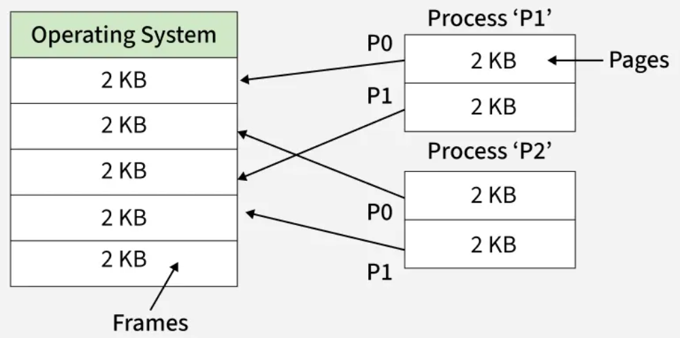
Non - Contiguous Memory Allocation
In order to avoid this time-consuming process, we divide our process in secondary memory in advance before reaching the main memory for its execution.
Every process is divided into various parts of equal size called Pages.
We also divide our main memory into different parts of equal size called Frames.
It is important to understand that:

Slide 8
PAGING
Paging is a memory management technique in which a process is divided into fixed-size blocks called pages, and the main memory (RAM) is divided into fixed-size blocks called frames. Pages of a process are mapped to any available frames in physical memory.
A process does not need to be allocated contiguous memory; its pages can be stored in different locations in main memory.
Paging simplifies memory allocation because memory is always allocated in fixed-size frames, eliminating external fragmentation.
Paging avoids external fragmentation, though it may suffer from internal fragmentation if a page is not fully utilized.
To keep track of where each page is stored in memory, the operating system uses a page table. This table shows the connection between the logical page numbers and the physical page frames (actual locations in RAM).

Slide 9
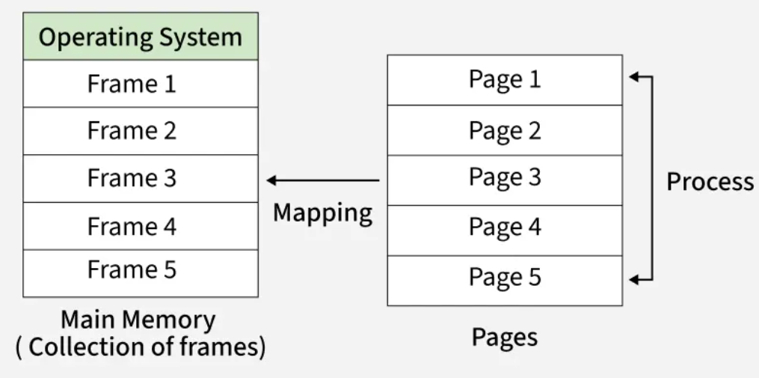
PAGING
The memory management unit (MMU) uses the page table to convert logical addresses into physical addresses, so the program can access the correct data in memory.

Slide 10
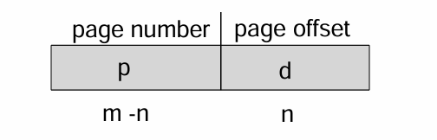
PAGING - Address Translation Scheme
Address generated by CPU is divided into:
Page number (p)– used as an index into a page table which contains base address of each page in physical memory
Page offset (d)– combined with base address to define the physical memory address that is sent to the memory unit.
For given logical address space 2m and page size2n

Slide 11
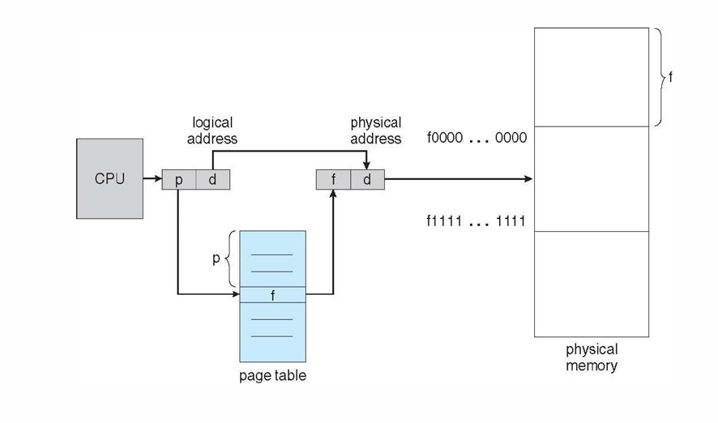
PAGING HARDWARE

Slide 12
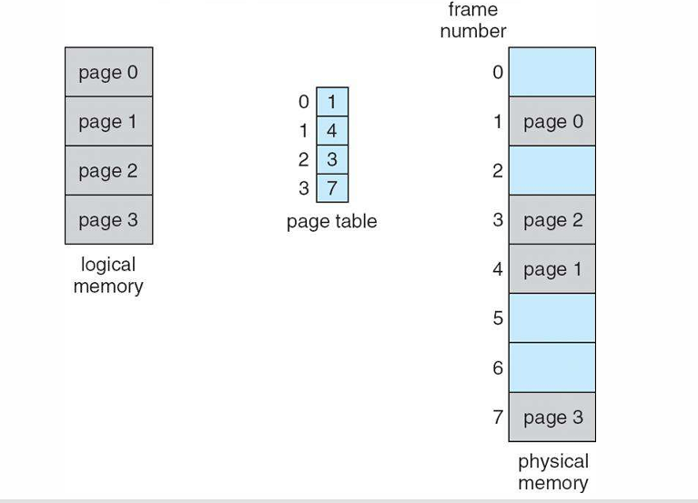
Paging Model of Logical and Physical Memory

Slide 13
IMPORTANT FEATURES OF PAGING
Logical to physical address mapping: Paging divides a process's logical address space into fixed-size pages. Each page maps to a frame in physical memory, enabling flexible memory management.
Fixed page and frame size: Pages and frames have the same fixed size. This simplifies memory management and improves system performance.
Page table entries: Each logical page is represented by a page table entry (PTE). A PTE stores the corresponding frame number and control bits.
Number of page table entries: The page table has one entry per logical page. Thus, its size equals the number of pages in the process's address space.
Page table stored in main memory: The page table is kept in main memory. This can add overhead when processes are swapped in or out.

Slide 14
Working OF PAGING
When a process requests memory, the operating system allocates one or more page frames to the process and maps the process's logical pages to the physical page frames.
When a program runs, its pages are loaded into any available frames in the physical memory.
Each program has a page table, which the operating system uses to keep track of where each page is stored in physical memory.
When a program accesses data, the system uses this table to convert the program's address into a physical memory address.
The mapping from virtual to physical address is done by the Memory Management Unit (MMU) which is a hardware device and this mapping is known as the paging technique.

Slide 15
Working OF PAGING
The Physical Address Space is conceptually divided into a number of fixed-size blocks, called frames.
The Logical Address Space is also split into fixed-size blocks, called pages.
Page Size = Frame Size
Steps :
Step 1 Divide Memory : Logical -> Pages, Physical -> Frames .
Step 2 Allocate Pages : Load pages into available frames.
Step 3 Page Table : Map logical pages to physical frames.
Step 4 Translate Address : Convert logical to physical address.
Step 5 Handle Page Fault : Load missing pages from disk.
Step 6 Run Program : CPU uses page table during execution.

Slide 16
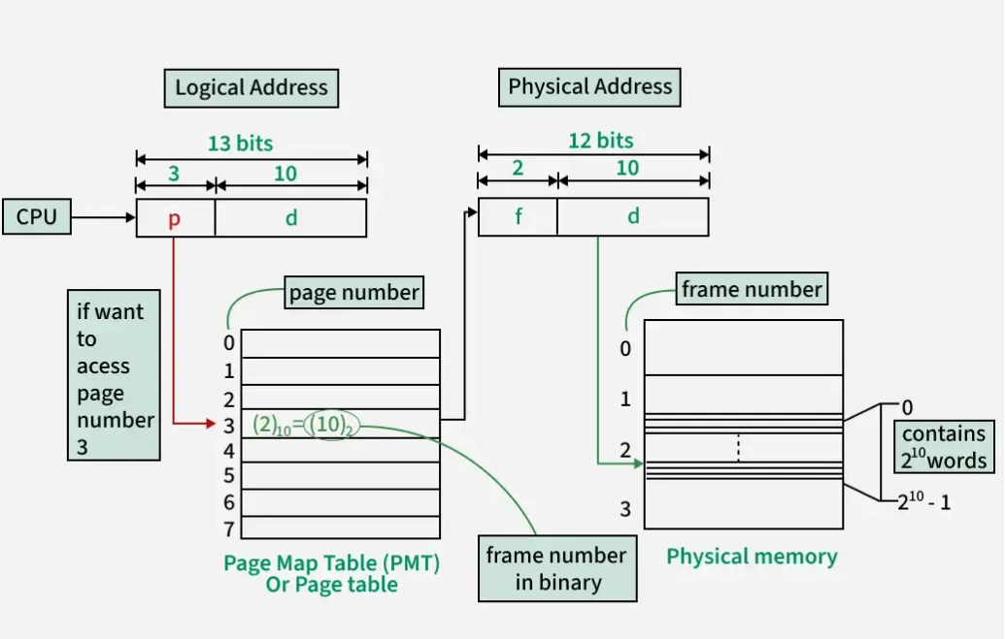

Slide 17
Working OF PAGING
The address generated by the CPU is divided into:
Page number(p): Number of bits required to represent the pages in Logical Address Space or Page number
Page offset(d): Number of bits required to represent a particular word in a page or page size of Logical Address Space or word number of a page or page offset.
A Physical Address is divided into two main parts:
Frame Number(f): Number of bits required to represent the frame of Physical Address Space or Frame number frame
Frame Offset(d): Number of bits required to represent a particular word in a frame or frame size of Physical Address Space or word number of a frame or frame offset.

Slide 18
Example - PAGING
Q: Consider a system which has LA = 7 bits, PA = 6 bits, Page size = 8 words then calculate the no: of page? And no of frames?
Solution:
No of pages: 2^4 = 16
No of frames: 2^3 = 8
Number of Entries in Pg Table = 16
Note: No. of entries in Pg table = No. of pages in process

Slide 19
FORMAT OF PAGE TABLE Entry (PTE)
Read, Write, Execute
User Modified Data
Present /
Absent
LRU
Enable / Disable
Frame No. | Valid (1) / Invalid (0) | Protection (R W X) | Reference 0/1 | Caching | Dirty / Modified
Optional Fields
Mandatory
Field

Slide 20
FORMAT OF PAGE TABLE
The page table is a data structure inside the operating system that maps logical addresses and physical addresses. Each entry in the page table contains the following information:
Frame Number − The frame number refer to the location of the page in physical memory.
Valid/Invalid Bit − This bit is used to know if the page is in memory (valid) or not (invalid).
Protection Bits − Bits that is used to indicate the permission of accessing the page (e.g., read, write, execute).
Dirty Bit − A bit that is used to indicate if the page has been modified since it was loaded into memory.
Reference Bit − A bit that is used to indicate whether the page has been accessed recently.

Slide 21
IMPLEMENTATION OF PAGE TABLE
Page table is kept in main memory
Page-table base register (PTBR) points to the page table
Page-table length register (PTLR) indicates size of the page table
In this scheme every data/instruction access requires two memory accesses
One for the page table and one for the data/ instruction
The two-memory access problem can be solved using a special fast-lookup hardware cache called associative memory or translation look-aside buffers (TLBs).

Slide 22
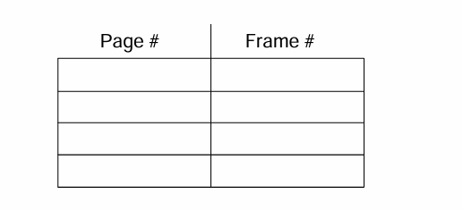
ASSOCIATIVE MEMORY
Associative memory – parallel search
Address translation (p, d)
If p is in associative register, get frame # out
Otherwise get frame # from page table in memory

Slide 23
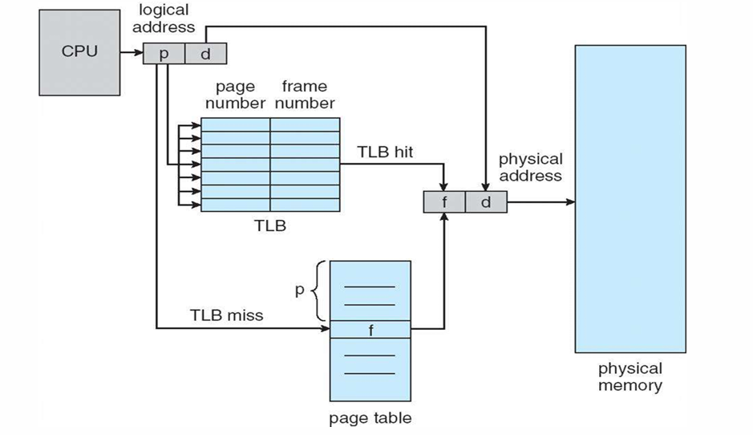
Paging hardware with tlb

Slide 24
IMPLEMENTATION OF PAGE TABLE
Some TLBs store address-space identifiers (ASIDs) in each TLB entry uniquely identifies each process to provide address-space protection for that process.
Otherwise need to flush at every context switch
TLBs typically small (64 to 1,024 entries)
On a TLB miss, value is loaded into the TLB for faster access next time
Replacement policies must be considered
Some entries can be wired down for permanent fast access.

Slide 25
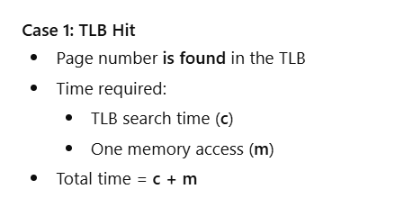
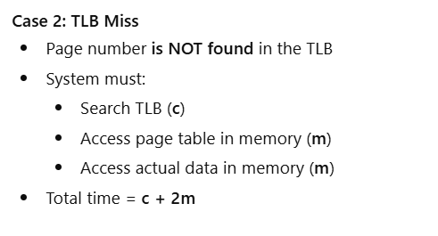
Two possible cases during memory access
So, we use:
Hit ratio (h) → probability of TLB hit
Miss ratio (1 − h) → probability of TLB miss
This leads to a weighted average, which reflects real system behavior, not best-case or worst-case.

Slide 26
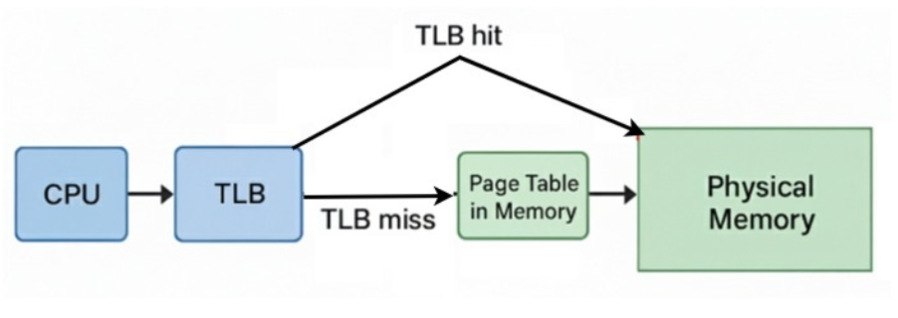
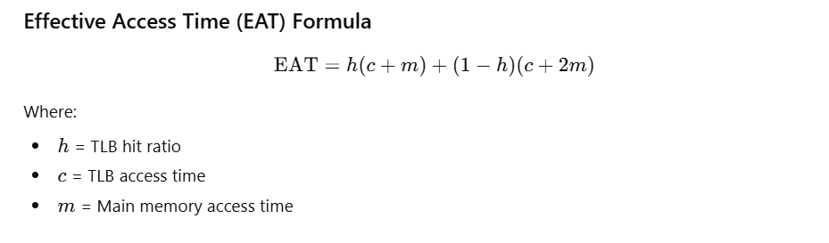
Effective access time (eat)

Slide 27
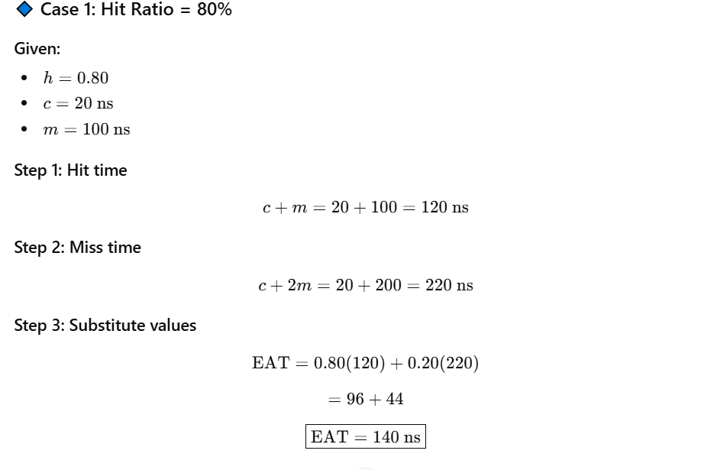
Effective access time (eat)

Slide 28
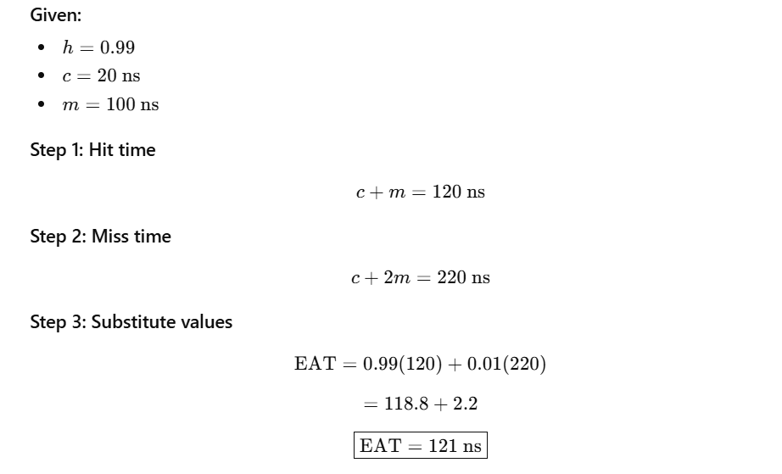
Effective access time (eat)
🔹 Case 2: More Realistic Hit Ratio = 99%

Slide 29
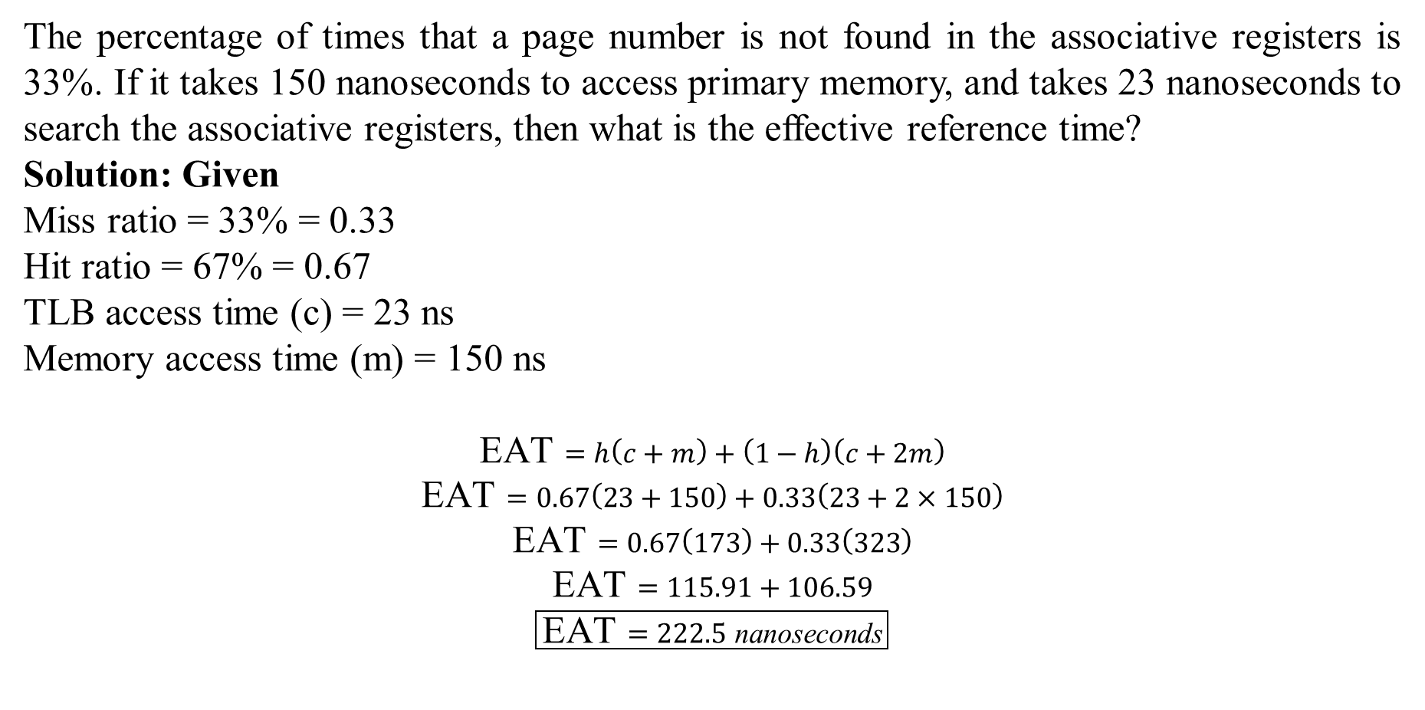
Example - Effective access time (eat)
The percentage of times that a page number is not found in the associative registers is 33%. If it takes 150 nanoseconds to access primary memory, and takes 23 nanoseconds to search the associative registers, then what is the effective reference time?
Solution: Given
Miss ratio = 33% = 0.33 Hit ratio = 67% = 0.67
TLB access time (c) = 23 ns Memory access time (m) = 150 ns
$$\text{EAT}=h\left(c+m\right)+\left(1−h\right)\left(c+2m\right)$$
$$\text{EAT}=0.67\left(23+150\right)+0.33\left(23+2×150\right)$$
$$\text{EAT}=0.67\left(173\right)+0.33\left(323\right)$$
$$\text{EAT}=115.91+106.59$$
$$\boxed{\text{EAT}=222.5 \text{nanoseconds}}$$

Slide 30
2 level paging / multilevel paging
Paging divides a process into fixed-size pages, which are mapped to fixed-size frames in main memory using a page table.
If the page table is small, it fits into one frame → simple paging.
If the page table is too large to fit in one frame, we divide the page table itself into pages.
Two-Level Paging
The page table is split into two levels:
Outer Page Table → points to pages of the inner page table
Inner Page Table → maps pages to frames
Used when the outer page table fits in one frame.
Multilevel Paging
If the outer page table is still too large, it is divided again.
This creates three or more levels of page tables.
Used for very large address spaces.

Slide 31
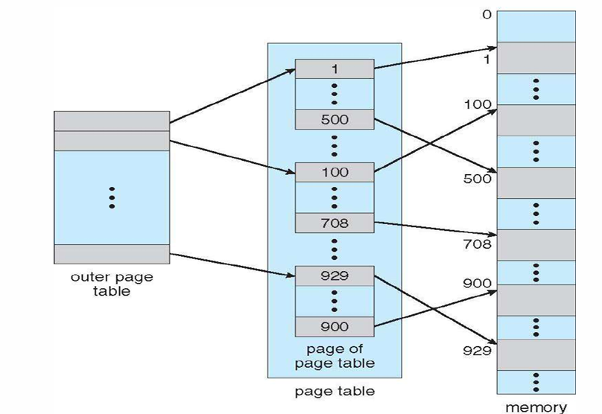
2 level paging / multilevel paging

Slide 32
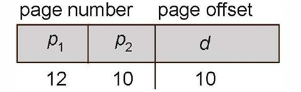
2 level paging Example
A logical address (on 32-bit machine with 1K page size) is divided into:
A page number consisting of 22 bits
A page offset consisting of 10 bits
Page Number Page Offset
22 10
Since the page table is paged, the page number is further divided into:
Thus, a logical address is as follows:
A 12-bit page number
A 10-bit page offset
Thus, a logical address is as follows:
where p1 is an index into the outer page table, and p2 is the displacement within the page of the inner page table.
It is known as forward-mapped page table.
p | d

Slide 33
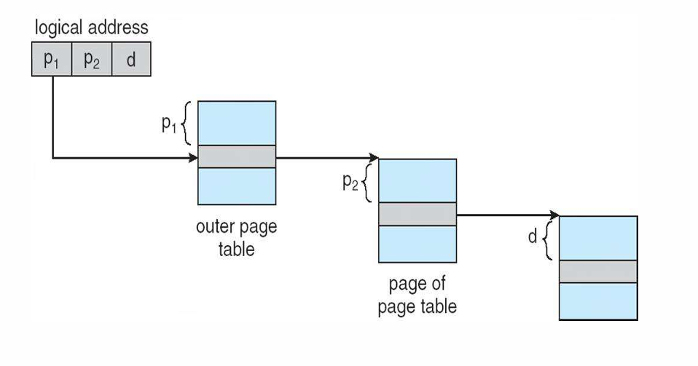
Address translation scheme

Slide 34
Inverted paging
Inverted paging in an OS is a memory management technique using a single, global page table indexed by physical frame numbers, not per-process logical pages, to map physical frames to virtual pages across all processes, saving space by only storing entries for frames in main memory, though it requires searching with a Process ID (PID) and page number to find the correct frame, often optimized with hashing. It efficiently manages large memory by reducing table size but can slow lookups, necessitating techniques like hash tables for speed.
Fr. Page Process
No No. ID
0
1
2
3
4
5
6
P0 | P1
P1 | P2
P2 | P1
P1 | P3
P3 | P2
P2 | P2
P3 | P3
0
1
2
3
X
F3
F5
0
1
2
3
F0
X
F2
0
1
2
3
X
F1
F4
X
X
X
Global Pg Table
Pg Table P1
Pg Table P2
Pg Table P3

Slide 35
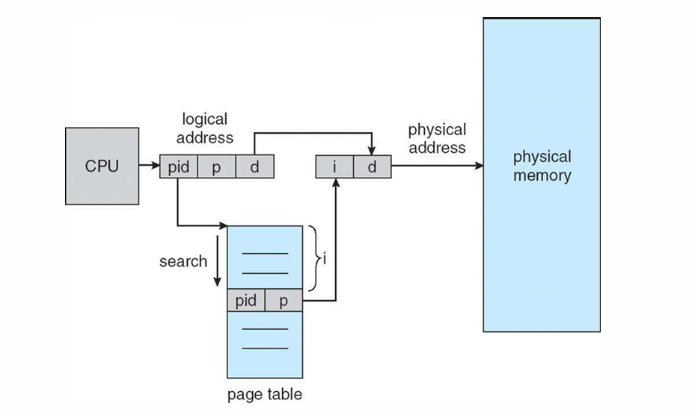
Inverted page table architecture
Disadvantage: Searching an inverted page table is slower and often requires hashing, which can increase access time compared to regular page tables.

Slide 36
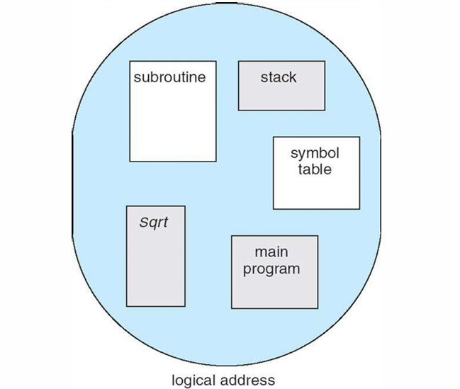
segmentation
Segmentation is a memory management technique where a process is divided into variable-sized chunks called segments. Unlike paging, segmentation matches the user’s logical view of a program (functions, arrays, modules) to physical memory.
It reflects the user’s view of memory rather than the computer’s physical organization, making it easier to manage and protect processes.

Slide 37
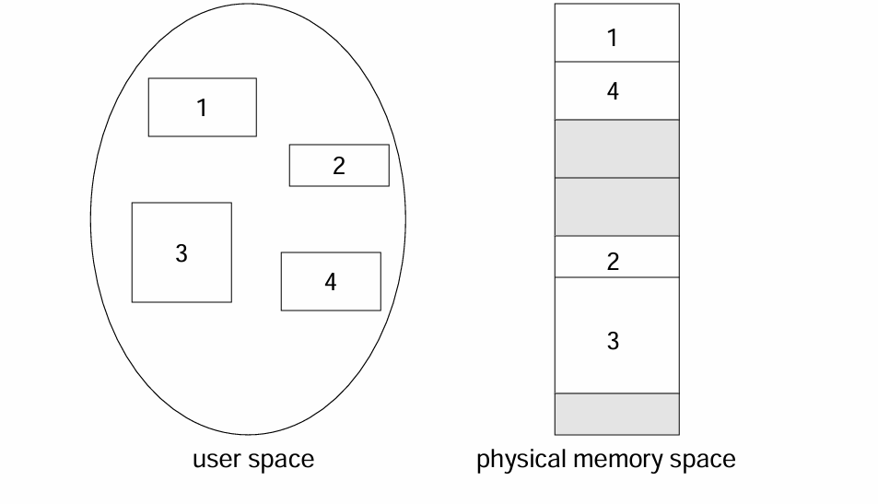
Logical view of segmentation

Slide 38
Segmentation architecture
1. Variable-sized divisions: Segments can have different lengths, depending on the program’s requirements. 2. Logical division of memory: Segments represent meaningful units like code, stack, data, or modules. 3. Two-part address: A logical address consists of:
Segment number (s): Identifies which segment is being referred to.
Offset (d): Specifies the exact location within that segment. Logical Address = ⟨Segment number, Offset⟩
Segment No. Segment Offset
s | d

Slide 39
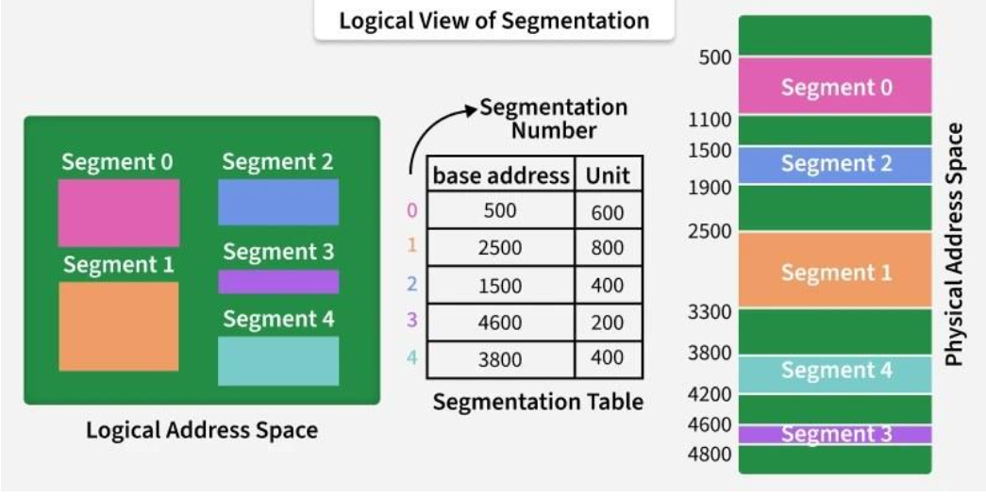
Segment table
It maps a two-dimensional Logical address into a one-dimensional Physical address. It's each table entry has:
Base Address: It contains the starting physical address where the segments reside in memory.
Segment Limit: Also known as segment offset. It specifies the length of the segment.

Slide 40
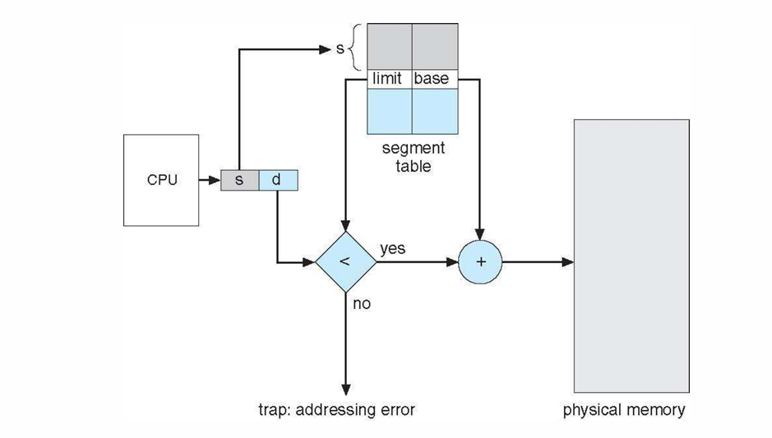
Segmentation hardware
Translation of Two-dimensional Logical Address to Dimensional Physical Address.

Slide 41
Paging vs Segmentation
Feature | Segmentation | Paging
Division | Divides memory into variable-sized segments (logical units: code, data, stack) | Divides memory into fixed-size pages
Size | Segments can be different sizes | Pages are equal size
Addressing | Logical address = segment number + offset | Logical address = page number + offset
External Fragmentation | Possible because segments are variable-sized | No external fragmentation (pages are fixed)
Internal Fragmentation | Less common | Can occur if the last page is partially filled
Memory Management | More complex; needs segment table | Simpler; uses page table
Example | Code segment, data segment, stack segment | Virtual memory pages (4KB each)

Slide 42
Thank you!
“Paging divides memory, but clever management keeps every process moving”

